Slide 1
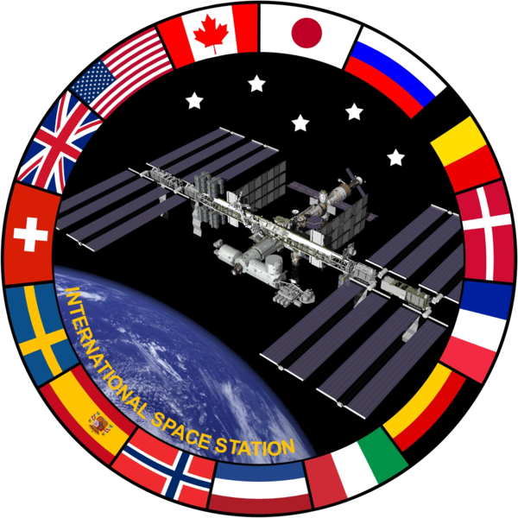
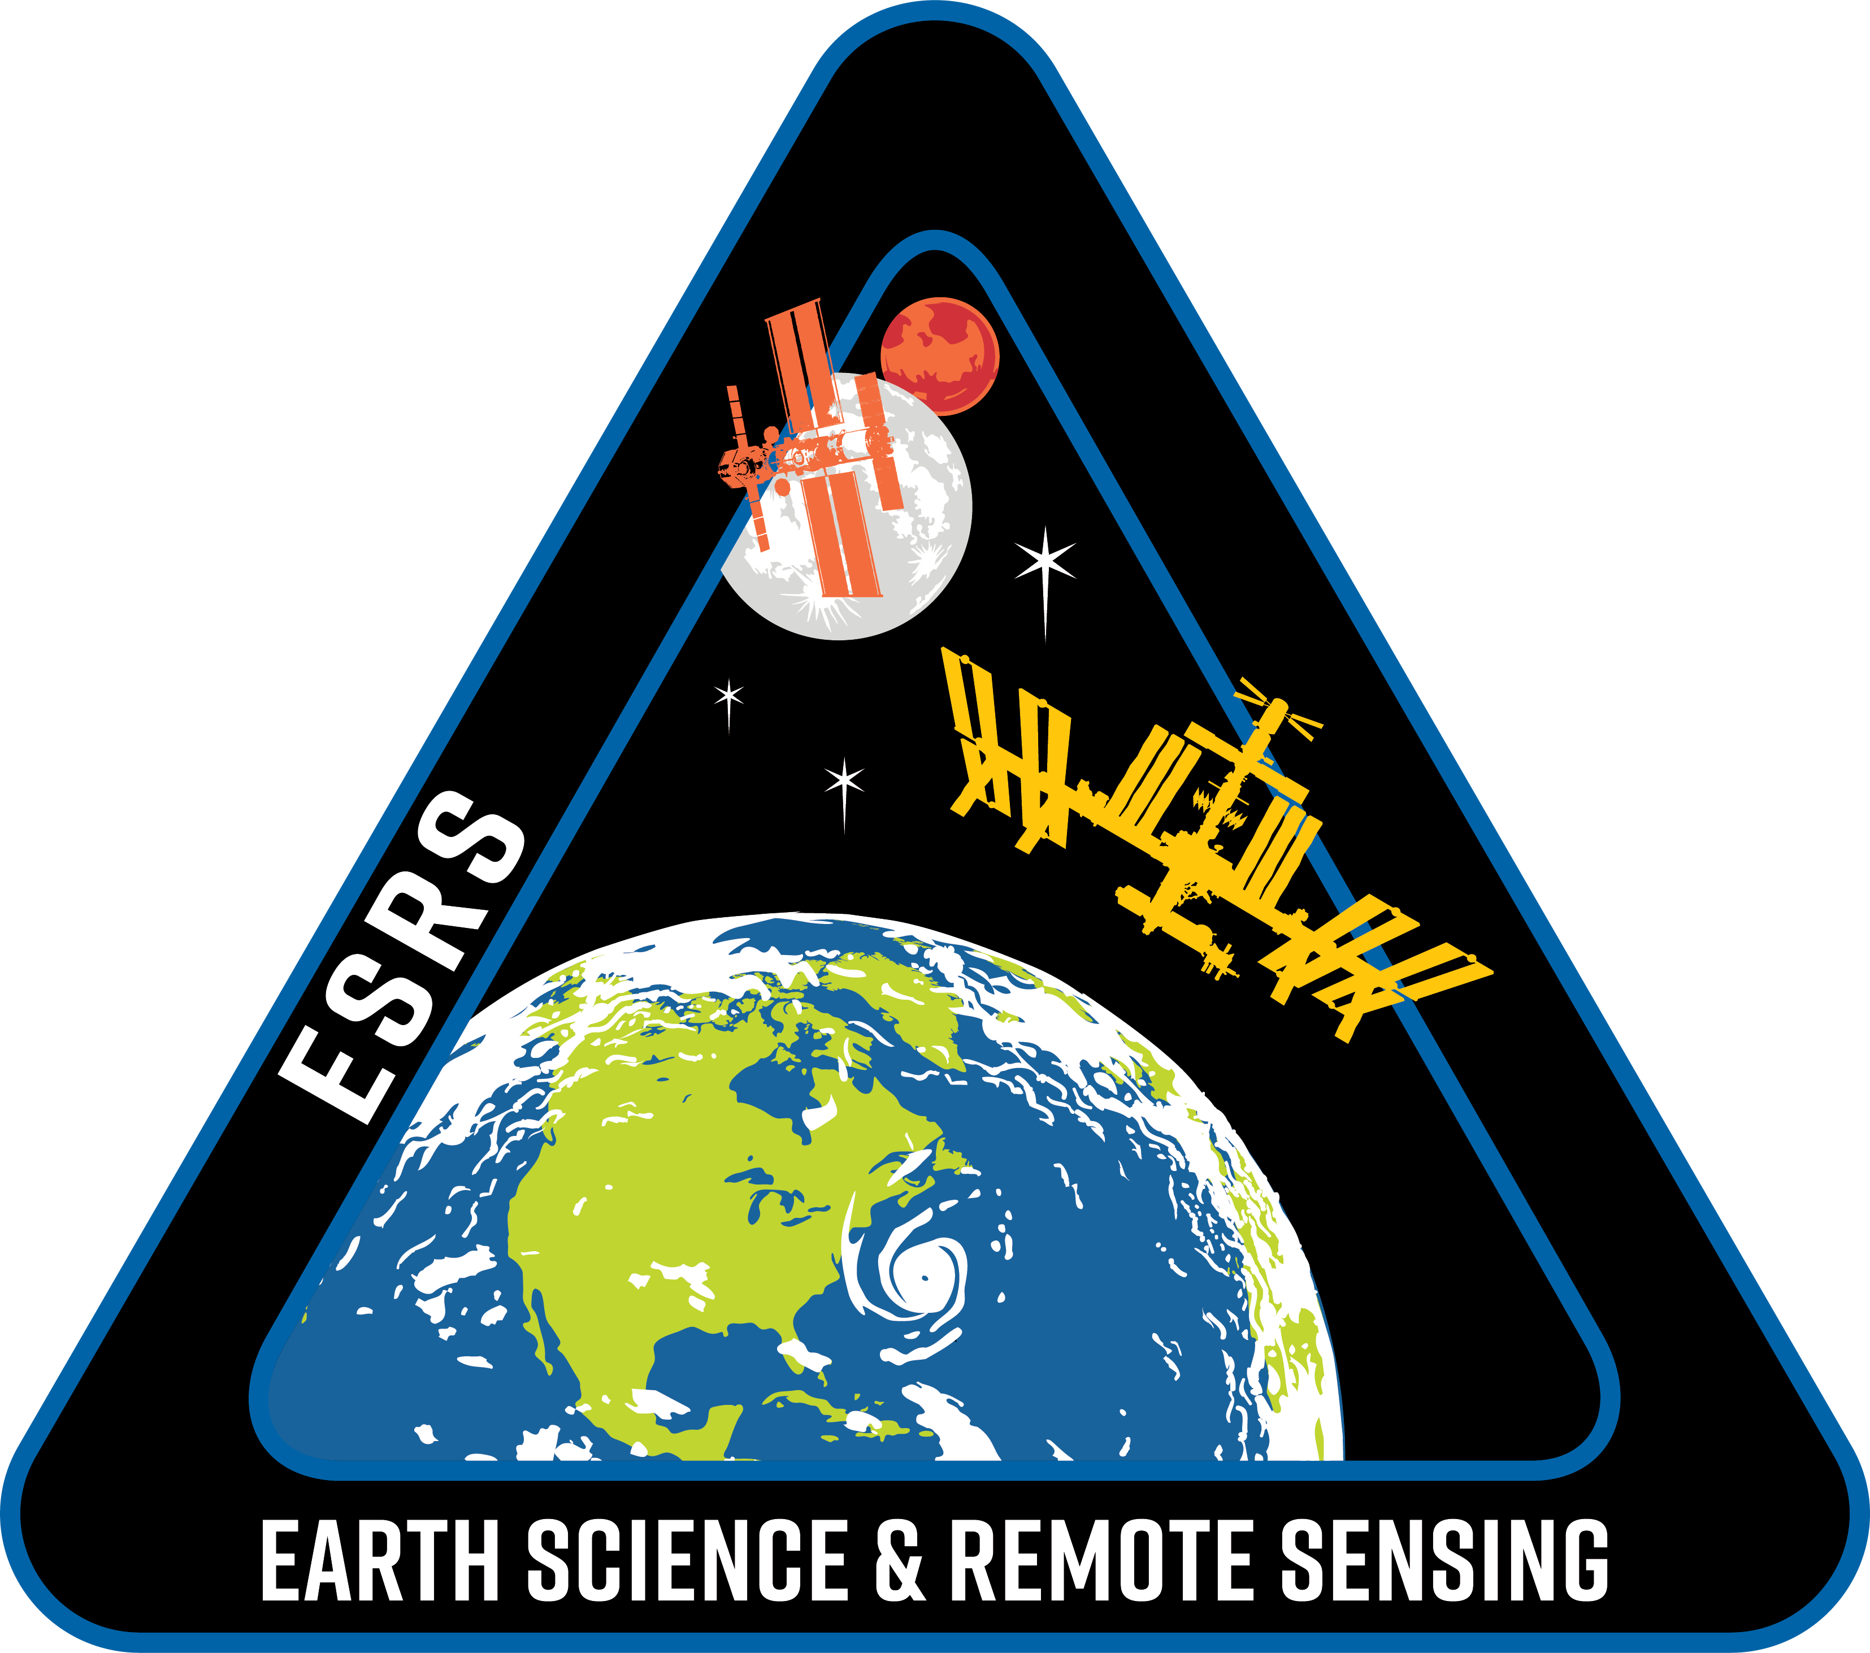
Find My Astronaut Photo
Alex Stoken¹ Kenton Fisher²
NASA Earth Science and Remote Sensing Unit
Jacobs Technology¹
NASA Johnson Space Center²

Slide 2
Overview
A Brief History of Astronaut Photography
Barriers to Geolocation
The Find My Astronaut Photo Framework
Finding a Discriminative Matcher
The AIMS Dataset
Results

Slide 3
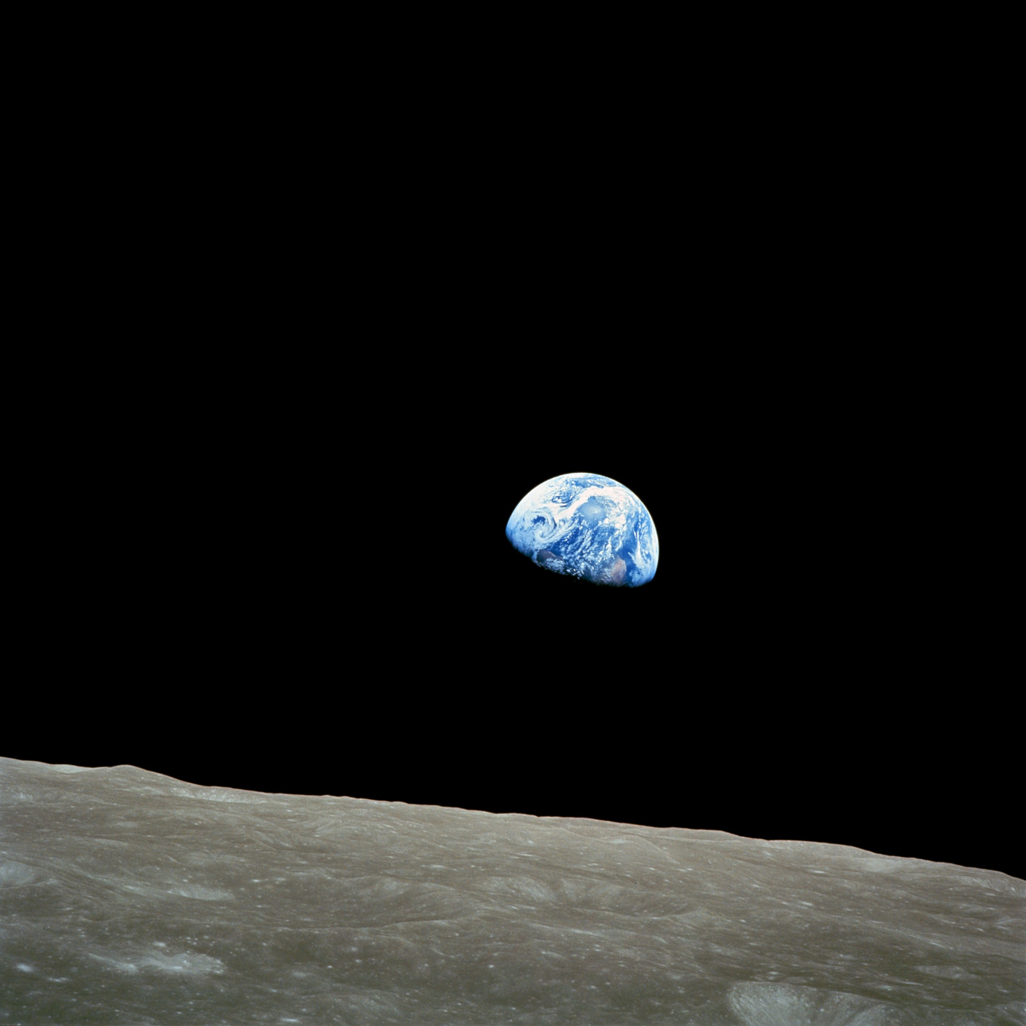
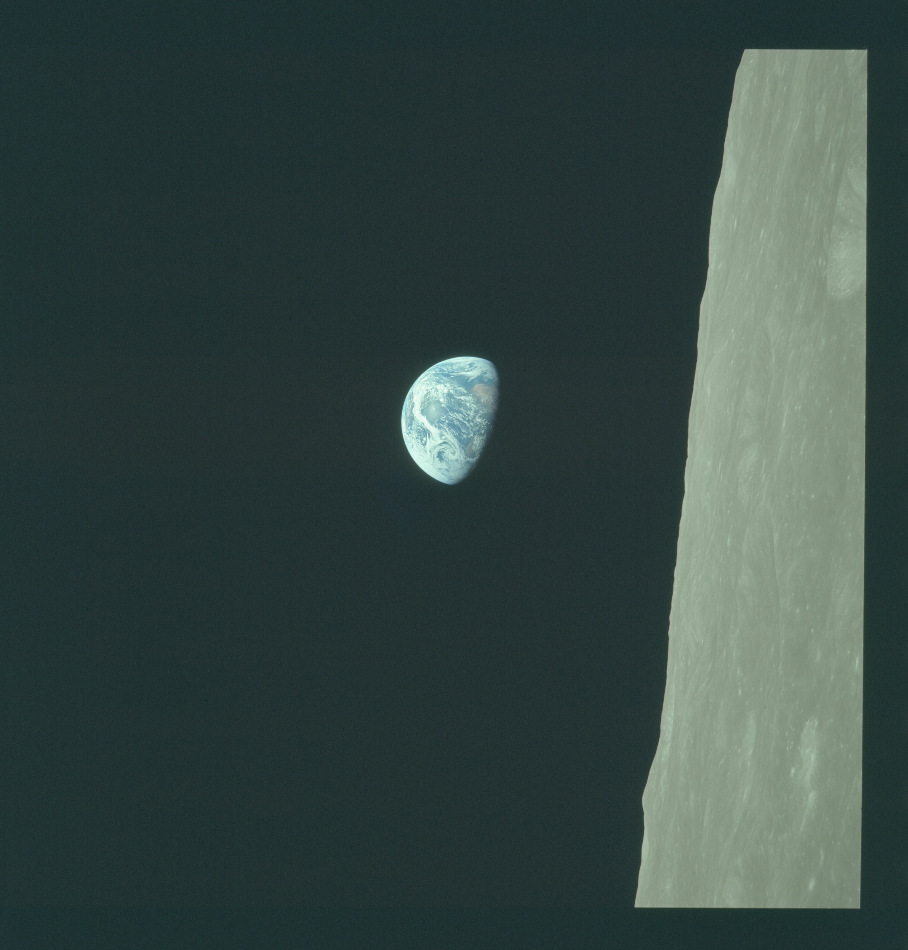
A Brief History of Astronaut Photography
Astronauts have taken photos of the Earth from space for over 60 years
The Earth Science and Remote Sensing (ESRS) Unit at JSC, manages the collection and hosting of Earth observation images from the ISS and past NASA spacecraft
Imagery is used for research, disaster response, and public engagement
A Brief History of Astronaut Photography
The Find My Astronaut Photo Framework
Finding a Discriminative Matcher
Results
Barriers to Geolocation
Notes:
First, lets take a brief walkthrough of the history of astronaut photography. Astronaut photography is as old as human spaceflight itself, and our database is a longitudinal record of the earth over the last half century plus. Today, astronaut photography is managed as the Crew Earth Observation facility by my team, the Earth Science and Remote Sensing Unit. We help orient crew members to find locations to take photos of, and manage and disseminate those photos once they are taken.
And who do we share these photos with? Earth and climate scientists, disaster response organizations, and the public. All have great use for this special imagery.
Internally, we divide the photographs into two categories: cataloged imagery, which has been viewed by a human and has had its location verified, and uncataloged imagery, which doesn’t have this location information.
Astronaut photography is just one of many remote sensing instruments on the ISS, but it has some unique properties.

Slide 4
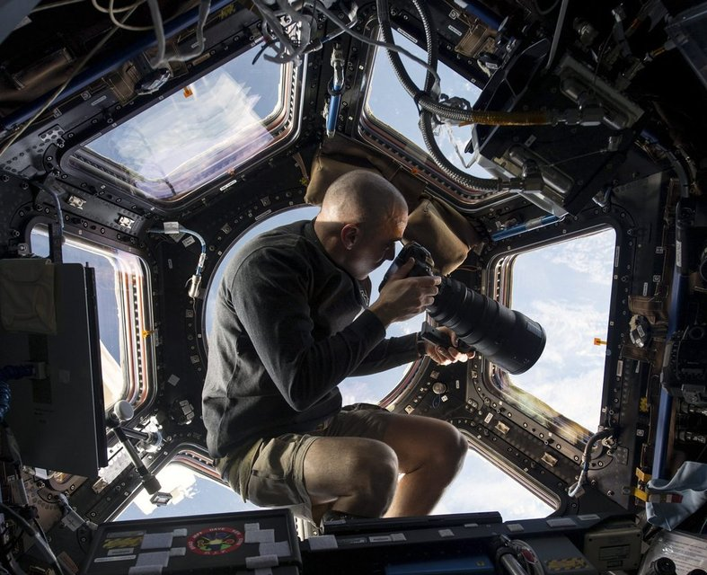
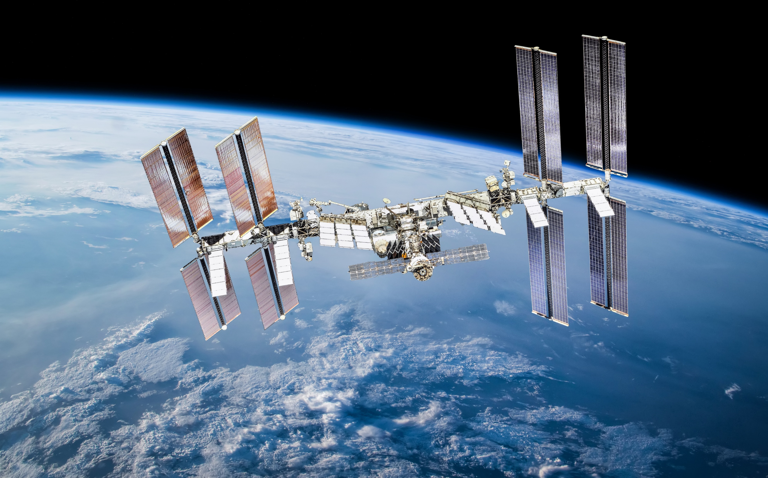
A Brief History of Astronaut Photography
Today, astronaut photography primarily takes place from the International Space Station (ISS)
400 km above Earth’s surface in Low Earth Orbit
Orbits the Earth 16 times per 24 hours
A Brief History of Astronaut Photography
The Find My Astronaut Photo Framework
Finding a Discriminative Matcher
Results
Barriers to Geolocation
Notes:
First, lets take a brief walkthrough of the history of astronaut photography. Astronaut photography is as old as human spaceflight itself, and our database is a longitudinal record of the earth over the last half century plus. Today, astronaut photography is managed as the Crew Earth Observation facility by my team, the Earth Science and Remote Sensing Unit. We help orient crew members to find locations to take photos of, and manage and disseminate those photos once they are taken.
And who do we share these photos with? Earth and climate scientists, disaster response organizations, and the public. All have great use for this special imagery.
Internally, we divide the photographs into two categories: cataloged imagery, which has been viewed by a human and has had its location verified, and uncataloged imagery, which doesn’t have this location information.
Astronaut photography is just one of many remote sensing instruments on the ISS, but it has some unique properties.

Slide 5
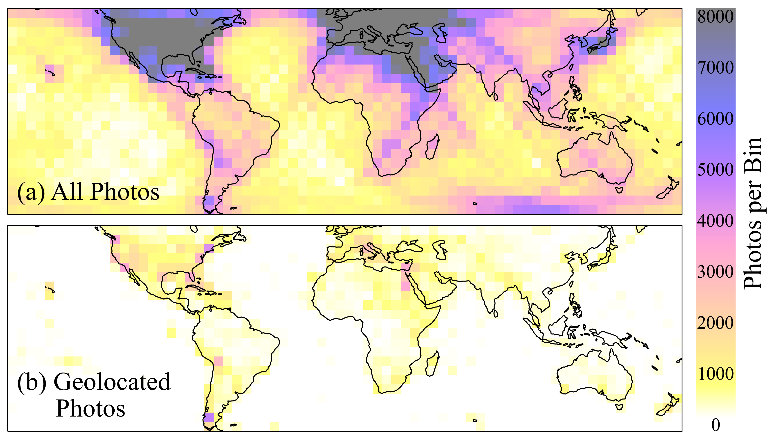
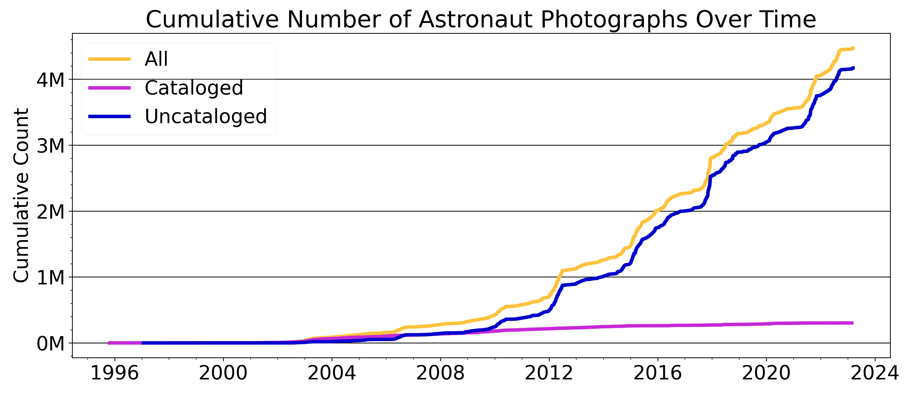
A Brief History of Astronaut Photography
Global, 4 million photo collection, increasing by 100,000 photos every 6 months
Missing critical geolocation data for 90% of images
10% of existing geolocation data is from manual human search and labeling
A Brief History of Astronaut Photography
The Find My Astronaut Photo Framework
Finding a Discriminative Matcher
Results
Barriers to Geolocation
Notes:
First, lets take a brief walkthrough of the history of astronaut photography. Astronaut photography is as old as human spaceflight itself, and our database is a longitudinal record of the earth over the last half century plus. Today, astronaut photography is managed as the Crew Earth Observation facility by my team, the Earth Science and Remote Sensing Unit. We help orient crew members to find locations to take photos of, and manage and disseminate those photos once they are taken.
And who do we share these photos with? Earth and climate scientists, disaster response organizations, and the public. All have great use for this special imagery.
Internally, we divide the photographs into two categories: cataloged imagery, which has been viewed by a human and has had its location verified, and uncataloged imagery, which doesn’t have this location information.
Astronaut photography is just one of many remote sensing instruments on the ISS, but it has some unique properties.

Slide 6
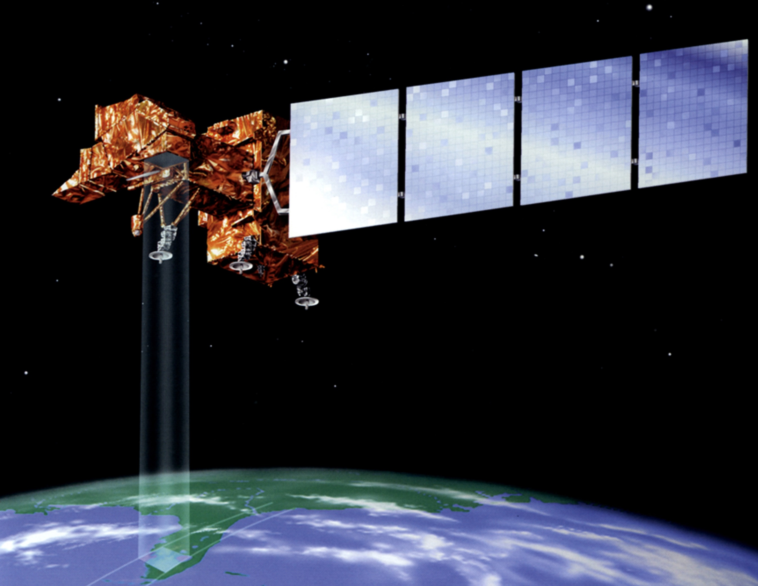
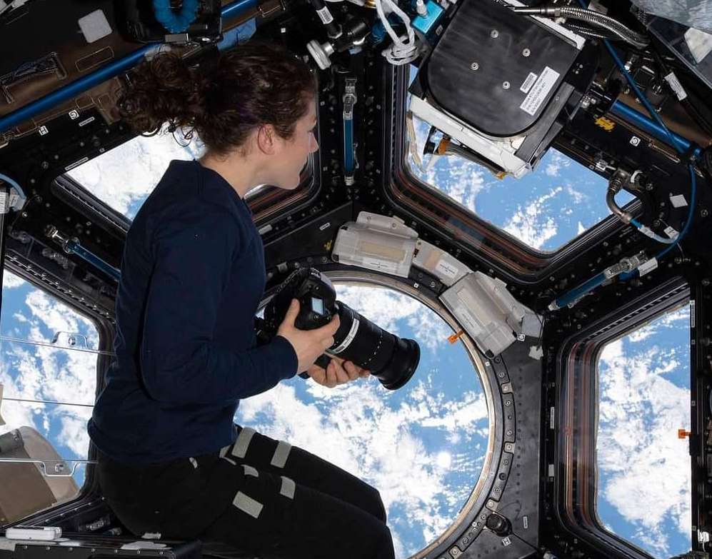
Satellite Image
Astronaut Photo
Acquisition Conditions
Known spacecraft position and attitude
Known camera orientation
A Brief History of Astronaut Photography
The Find My Astronaut Photo Framework
Finding a Discriminative Matcher
Results
Barriers to Geolocation
Notes:
Compare with sat imgagery

Slide 7
2,500 km away!

Slide 8
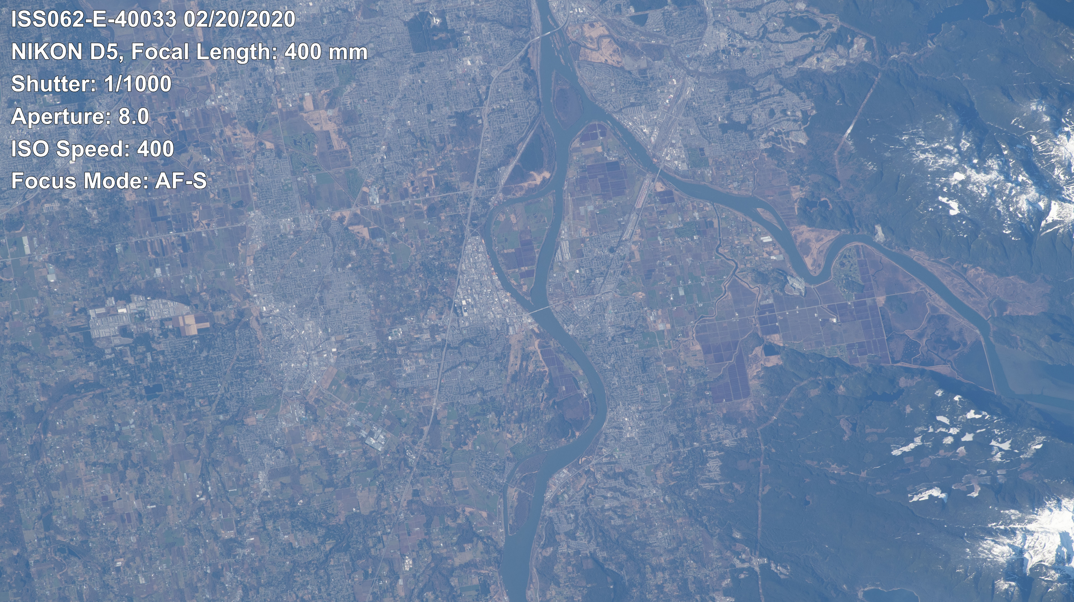

Slide 9
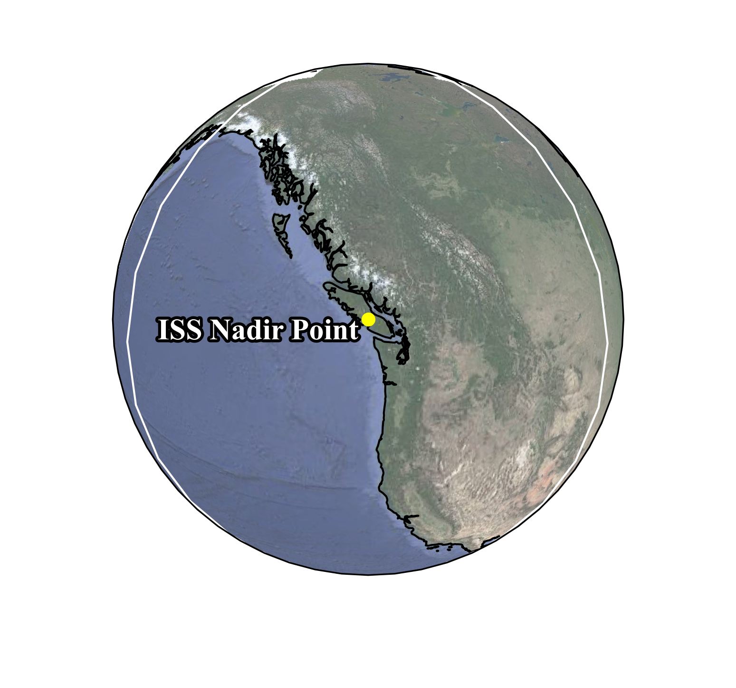
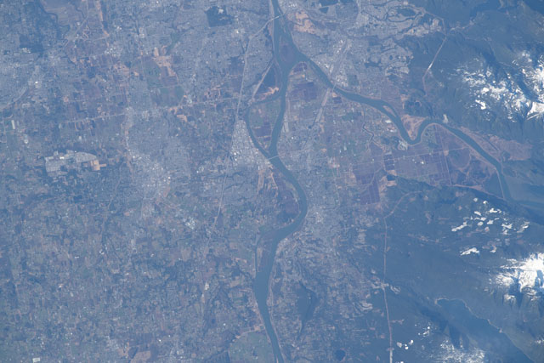
How on Earth do we find where on Earth?
Extent of
visible
Earth area
Image Metadata
Timestamp
Focal Length
A Brief History of Astronaut Photography
The Find My Astronaut Photo Framework
Finding a Discriminative Matcher
Results
Barriers to Geolocation

Slide 10
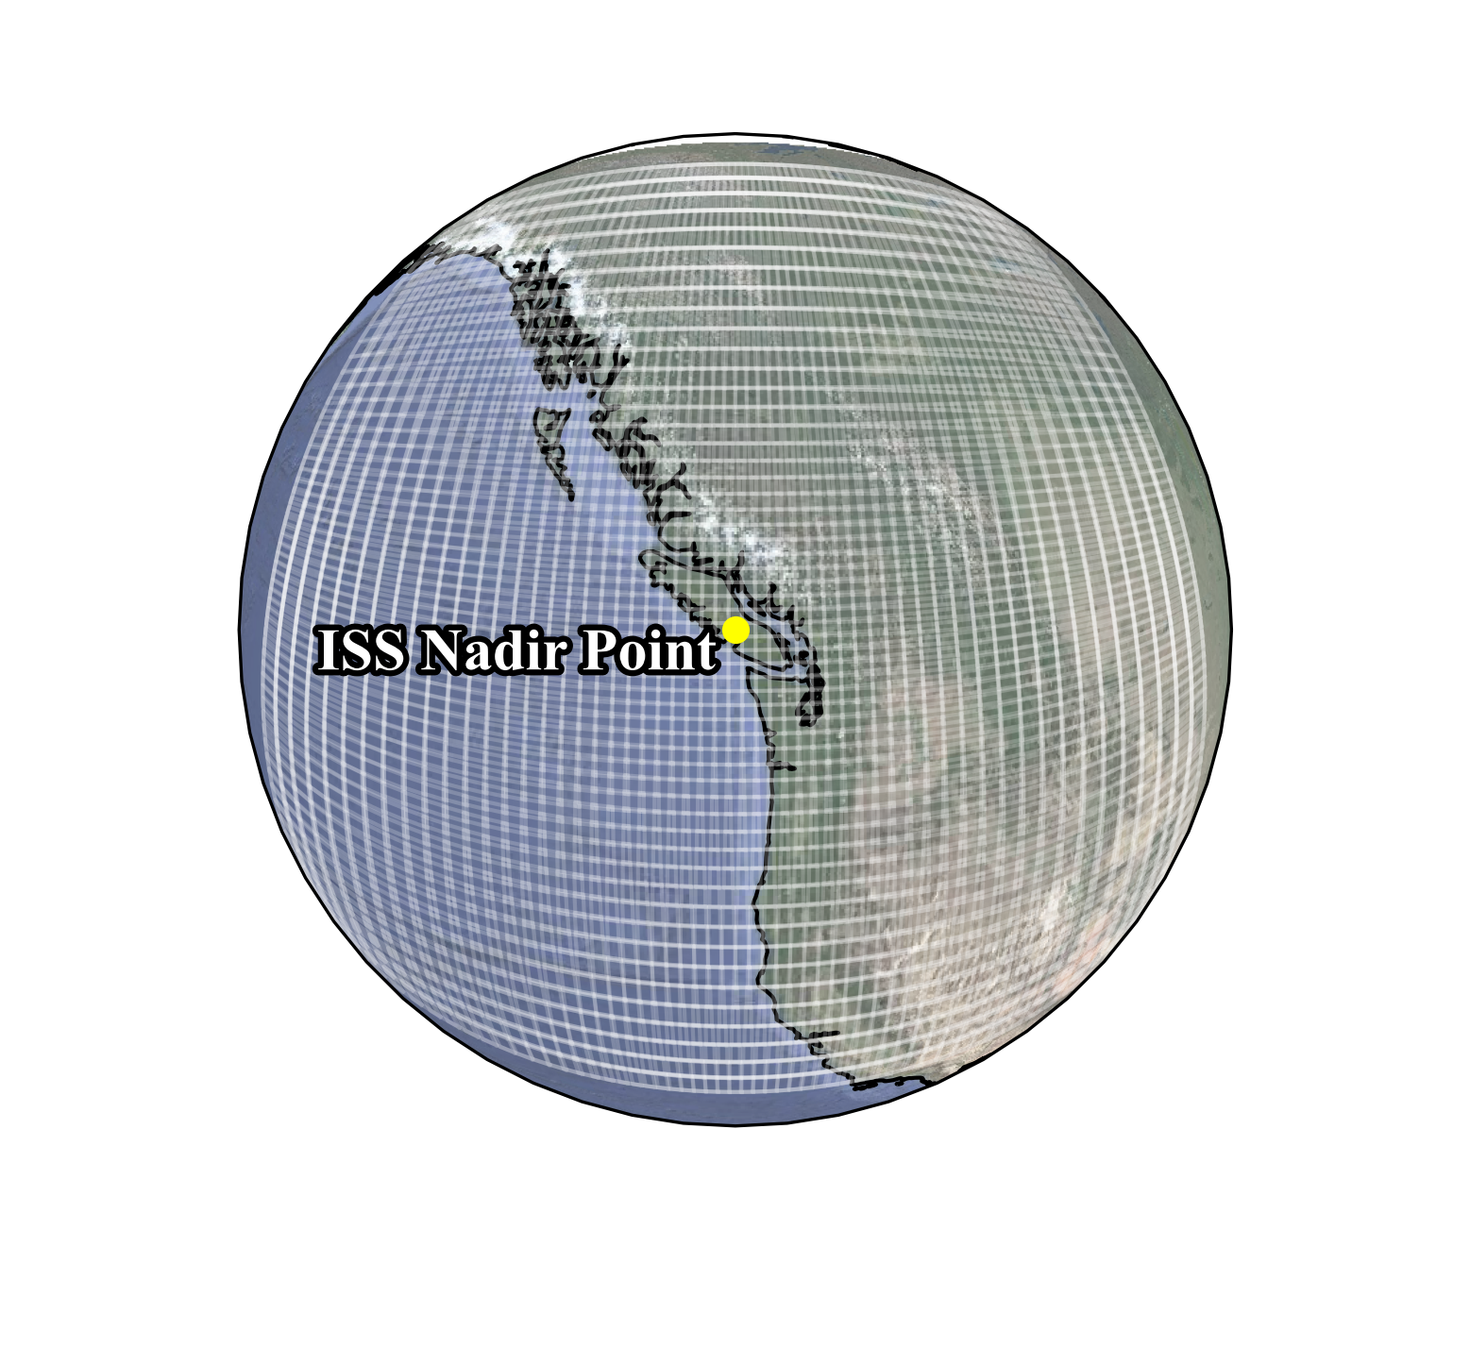
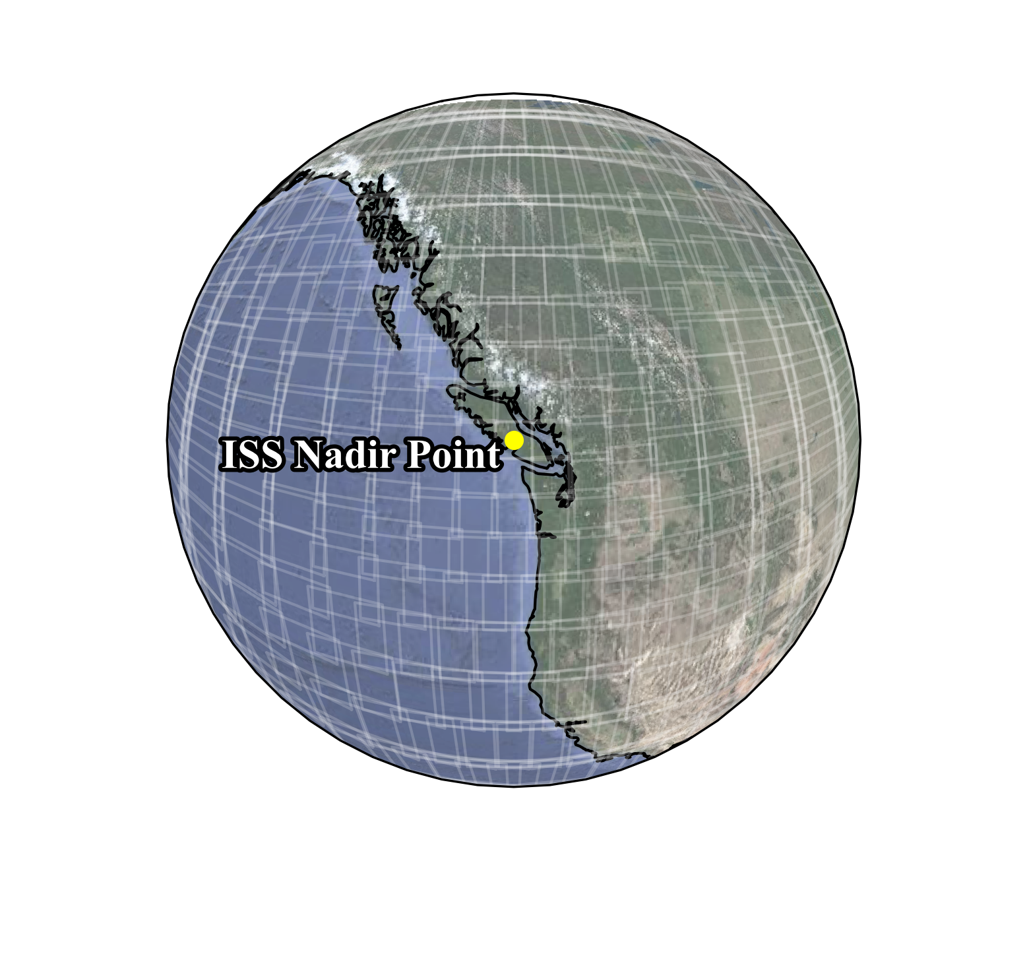
How on Earth do we find where on Earth?
Discretize visible Earth area into patches based on camera focal length
Different focal lengths will result in different ground fields of view and different patches
400 mm
100 mm
A Brief History of Astronaut Photography
The Find My Astronaut Photo Framework
Finding a Discriminative Matcher
Results
Barriers to Geolocation

Slide 11
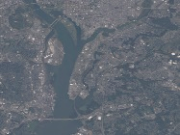
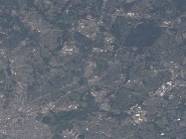
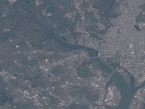
How on Earth do we find where on Earth?
For each patch, generate a satellite reference image with the extent of the patch
Satellite images are geolocated during acquisition
Satellite Image Repository
A Brief History of Astronaut Photography
The Find My Astronaut Photo Framework
Finding a Discriminative Matcher
Results
Barriers to Geolocation

Slide 12
How on Earth do we find where on Earth?
Using an image matching method, determine if the patch represents the same physical location on Earth
Matcher
Matching Criteria
Good match! Continue to fine localization
Not a match – try another patch
A Brief History of Astronaut Photography
The Find My Astronaut Photo Framework
Finding a Discriminative Matcher
Results
Barriers to Geolocation

Slide 13
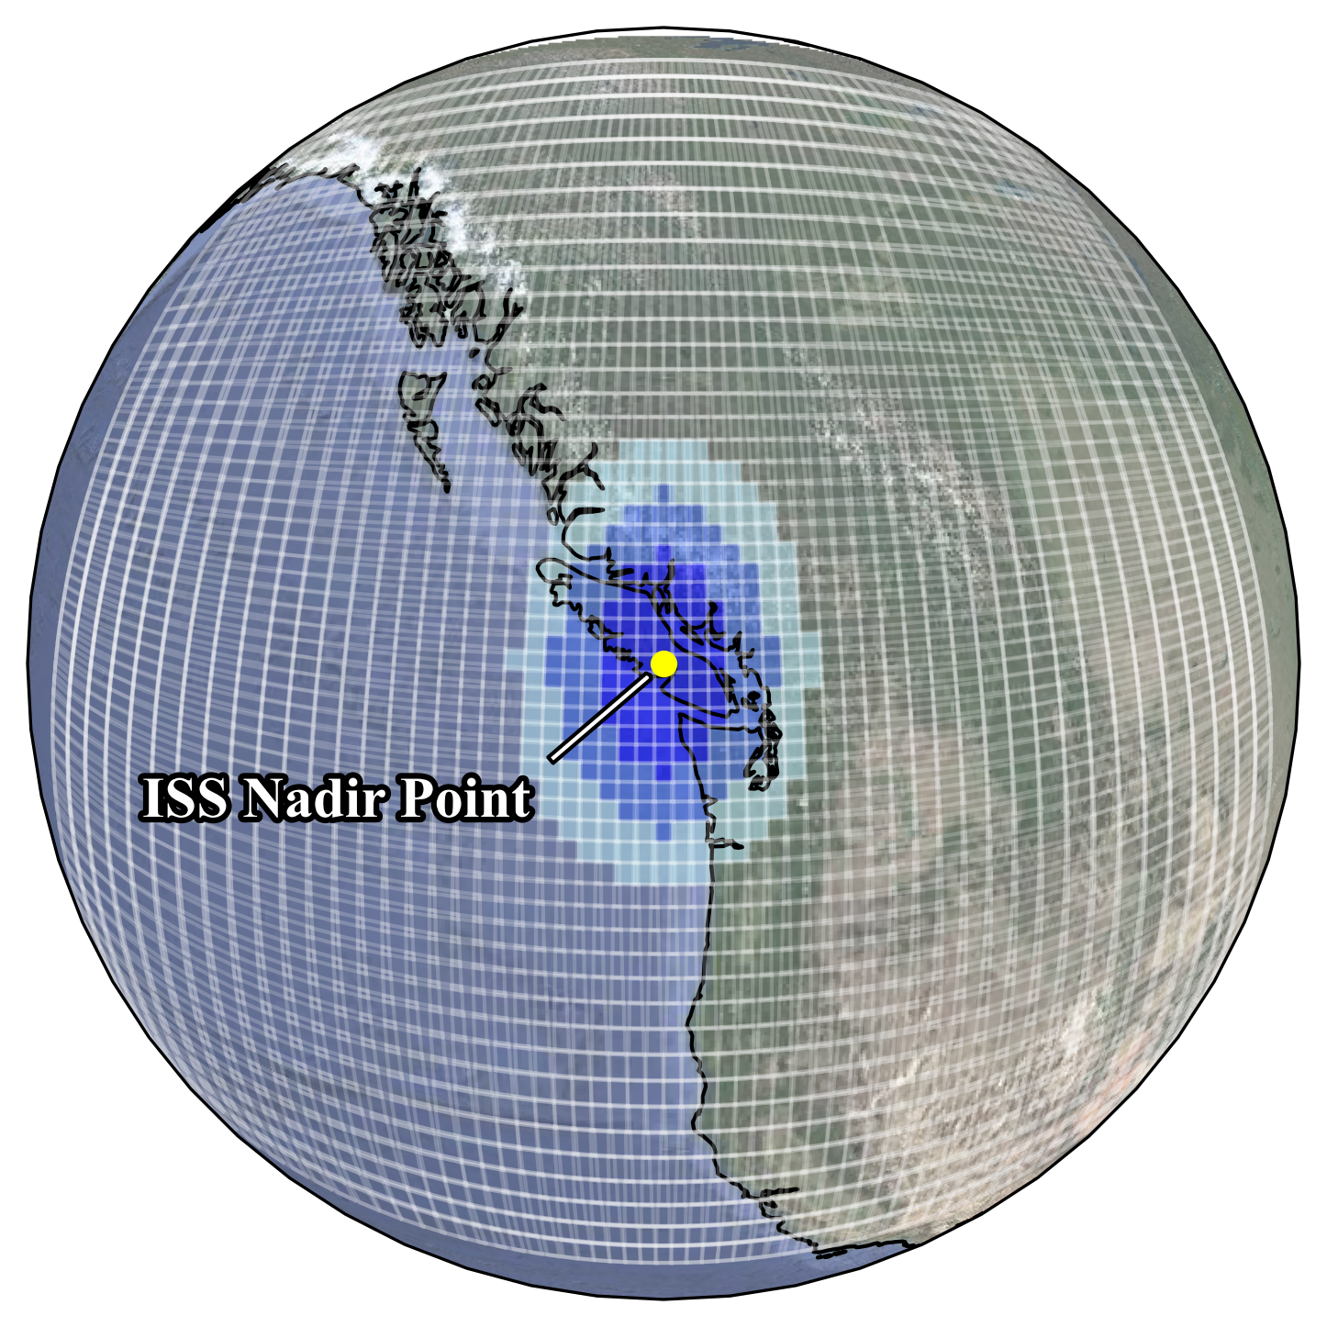
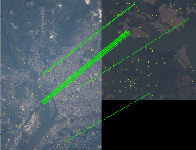
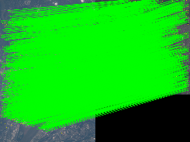
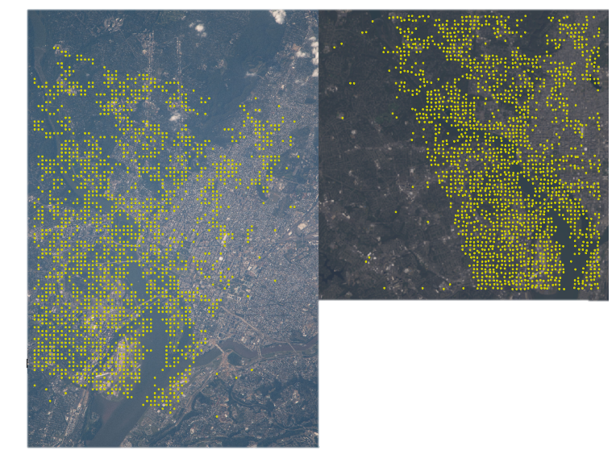
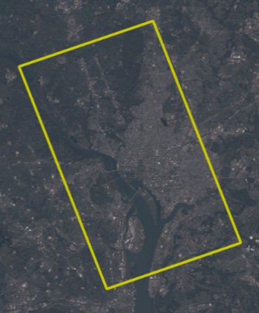
Q: How on Earth do we find where on Earth?
(a)
(b)
satellite image generation
A: The Find My Astronaut Photo Pipeline
Astronaut Photo
Satellite Image Repository
Image Metadata
Timestamp
Focal Length
(c)
(d)
Correspondences Tiepoints Transform
Matcher
RANSAC
Dissimilar
Get new image
Similar
Get tie points
(49⁰, 120 ⁰)

Slide 14
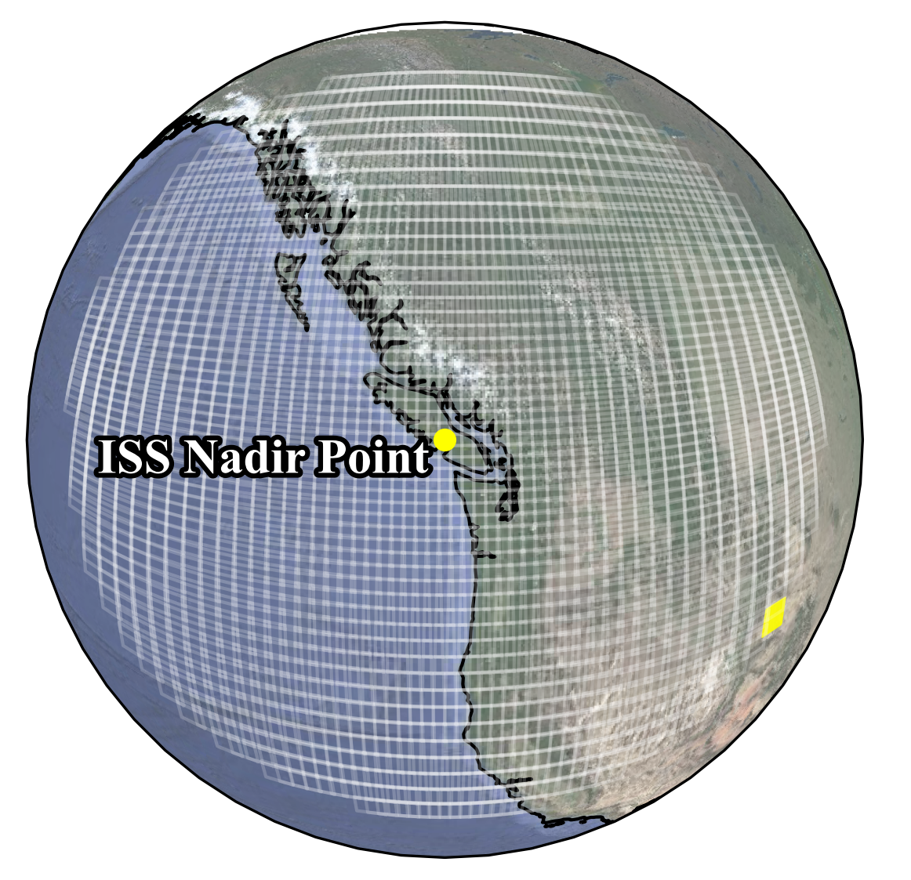
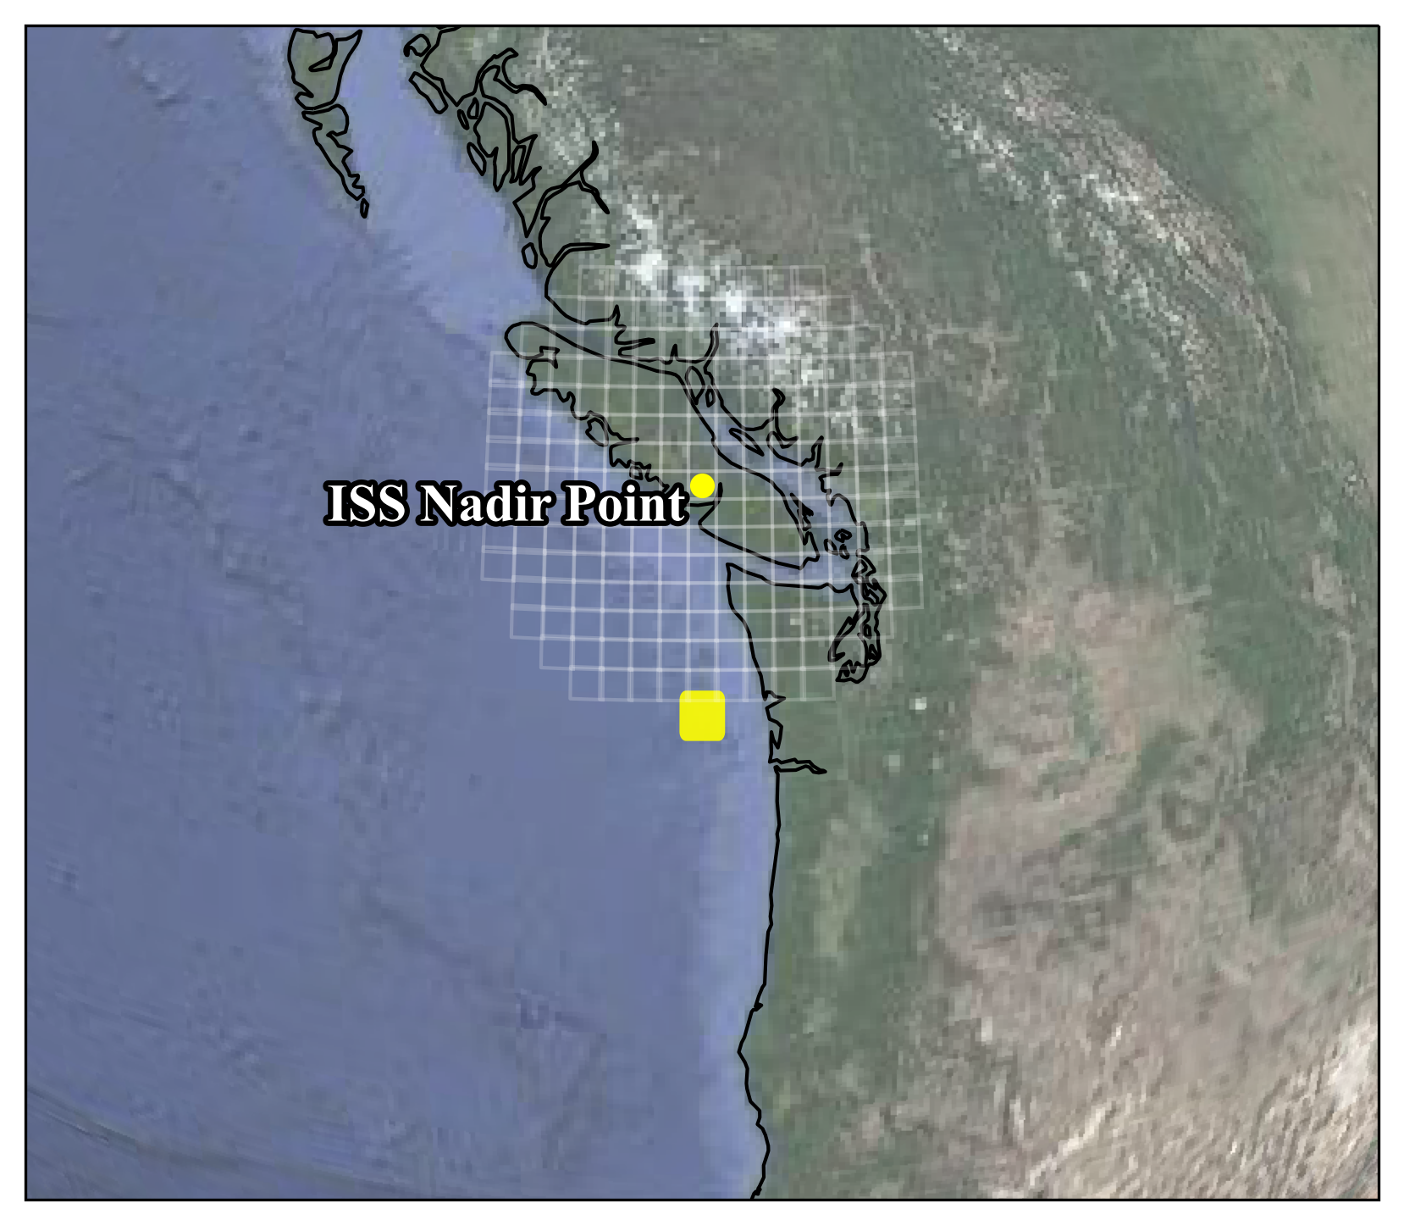
Finding a strong matcher
Challenge
Requirement
Finding the best match requires checking each patch
For higher focal length imagery, there can be 10,000+ patches
Checking just one patch is resource intensive
Matcher must be discriminative we can determine criteria such that we need not visit every patch if we find a good match (early stopping)
Visited Patches: 200
Visited Patches: 2500
We don’t need to check this space!
Good Match
A Brief History of Astronaut Photography
The Find My Astronaut Photo Framework
Finding a Discriminative Matcher
Results
Barriers to Geolocation

Slide 15
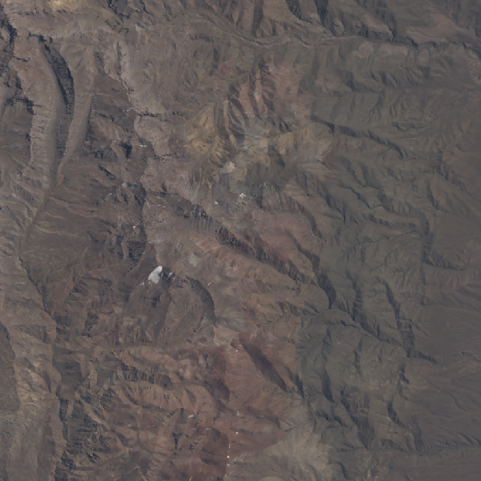
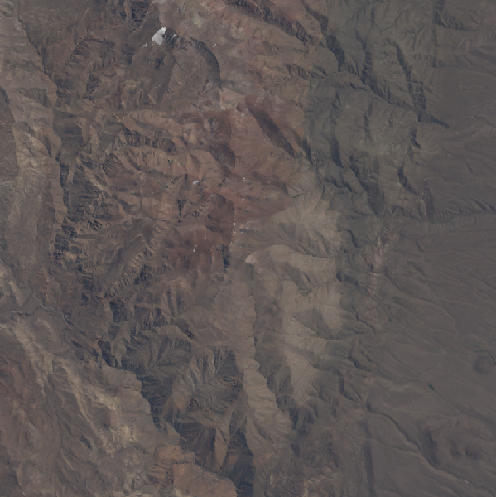
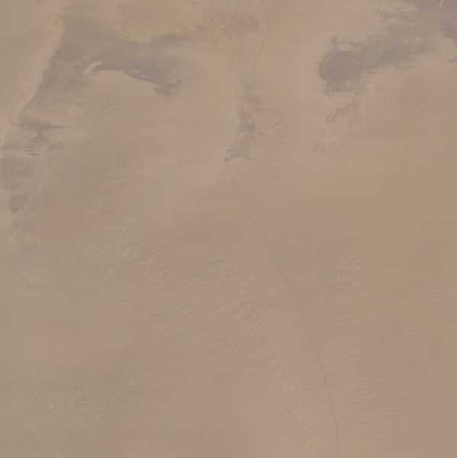
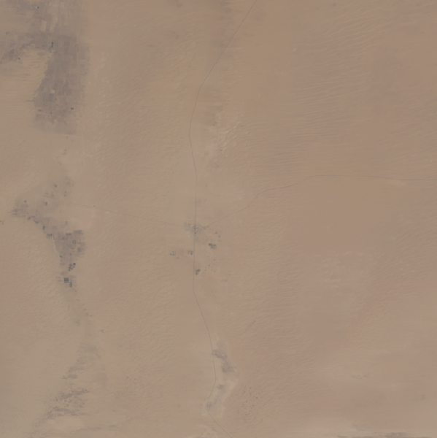
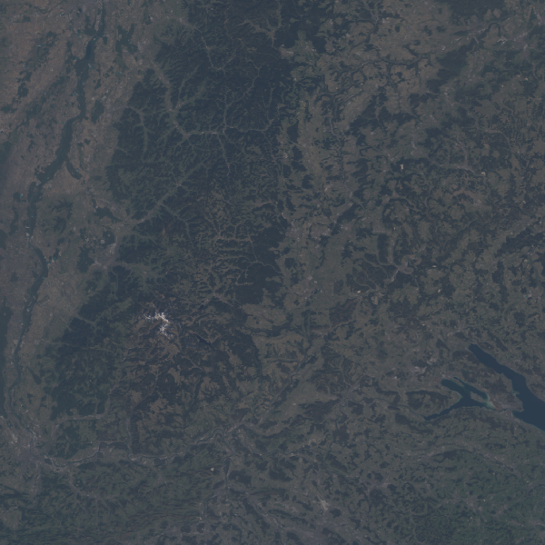
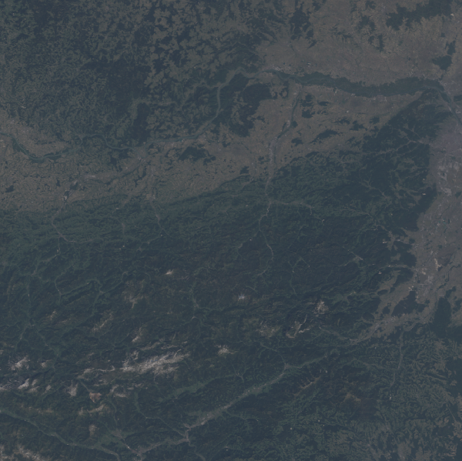
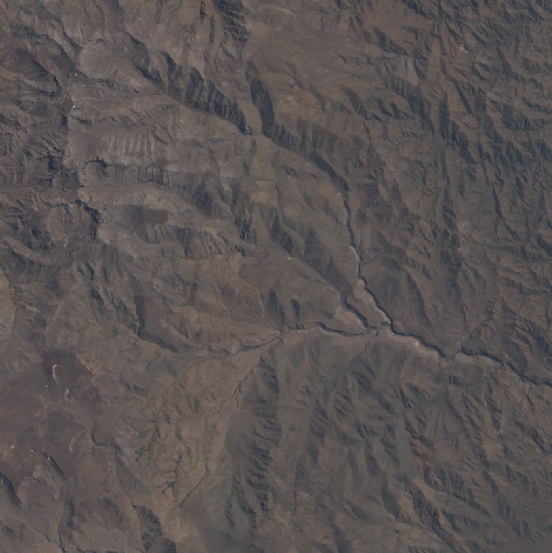
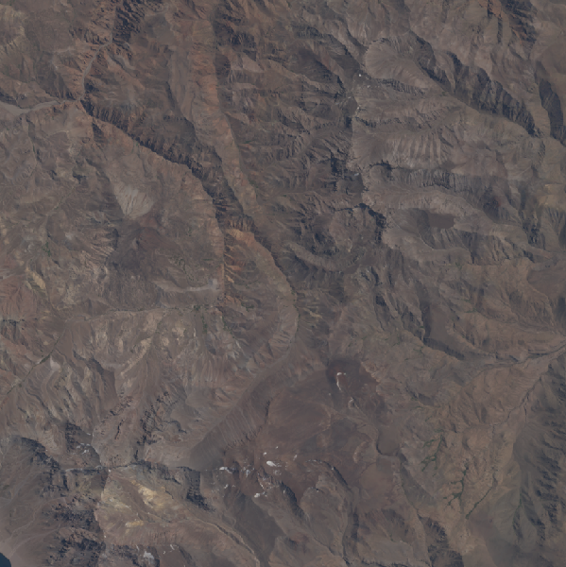
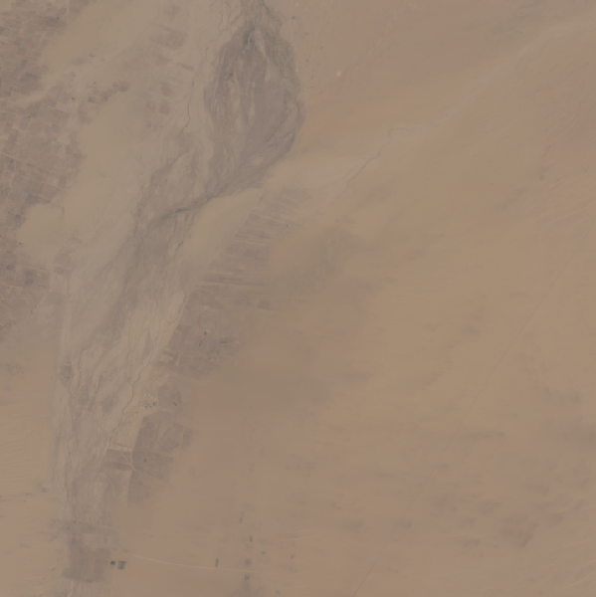
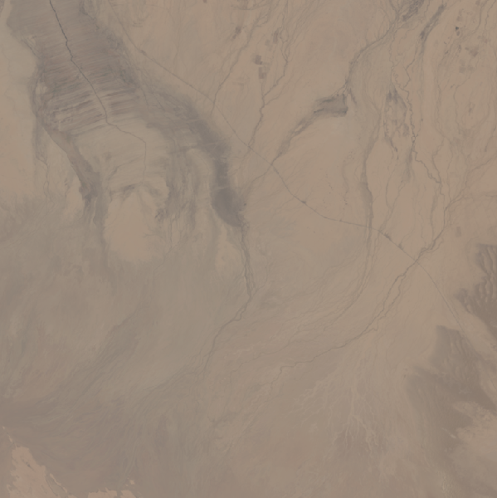
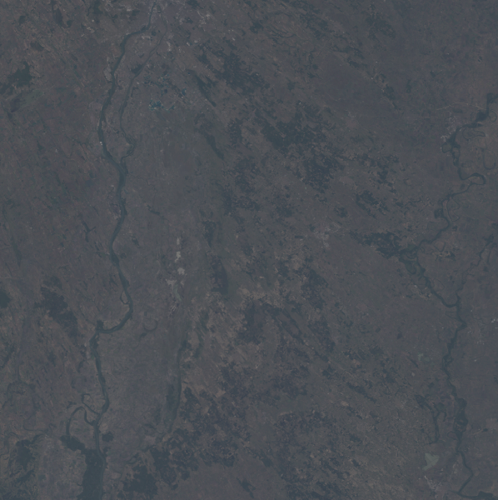
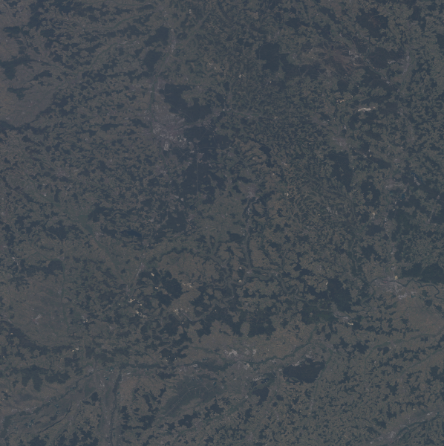
Finding a strong matcher
Challenge
Requirement
Many areas on Earth appear similar or have little texture
Matcher and matching criteria must minimize false positives
1
2
1
2
1
2
3
4
3
4
3
4
A Brief History of Astronaut Photography
The Find My Astronaut Photo Framework
Finding a Discriminative Matcher
Results
Barriers to Geolocation

Slide 16
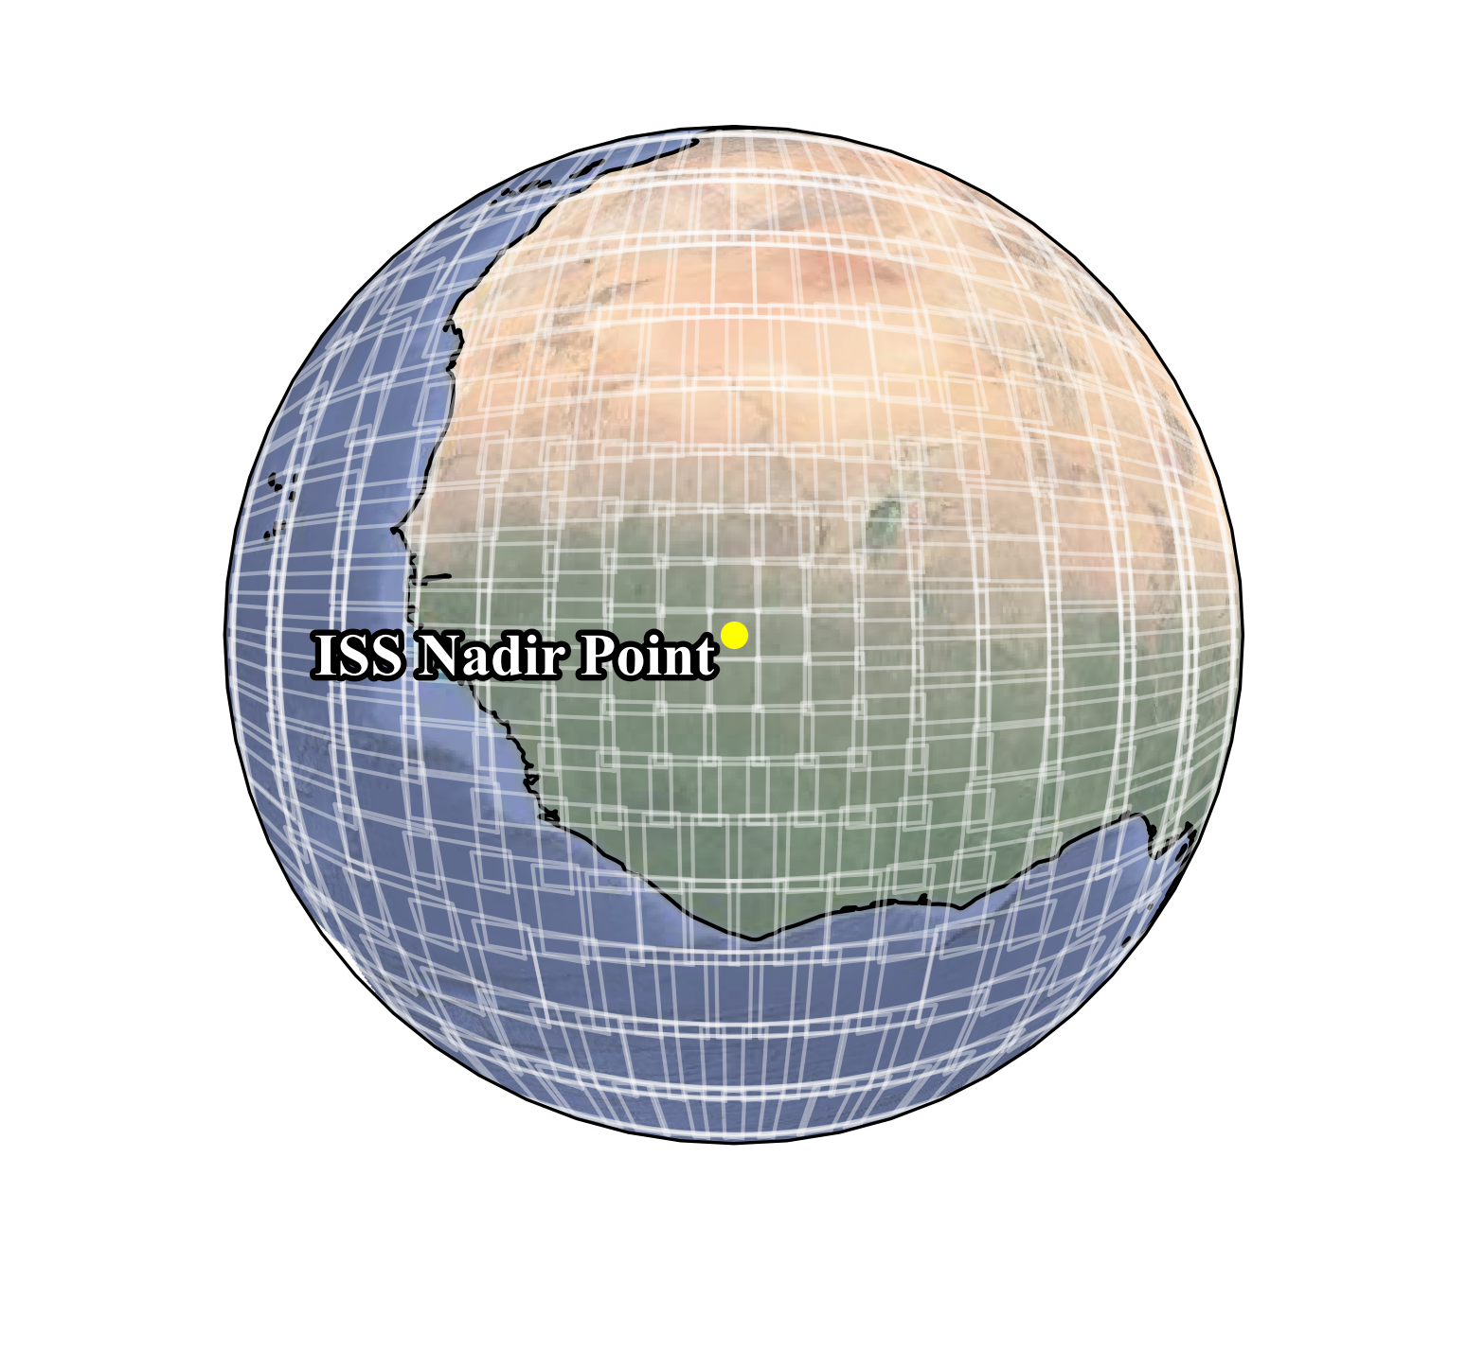
Finding a strong matcher
Challenge
Requirement
Each astronaut photo has a unique set of patches that vary in scale and location
We cannot precompute features for patches – no static database
Scale robustness allows for more leniency in patch generation
A Brief History of Astronaut Photography
The Find My Astronaut Photo Framework
Finding a Discriminative Matcher
Results
Barriers to Geolocation

Slide 17
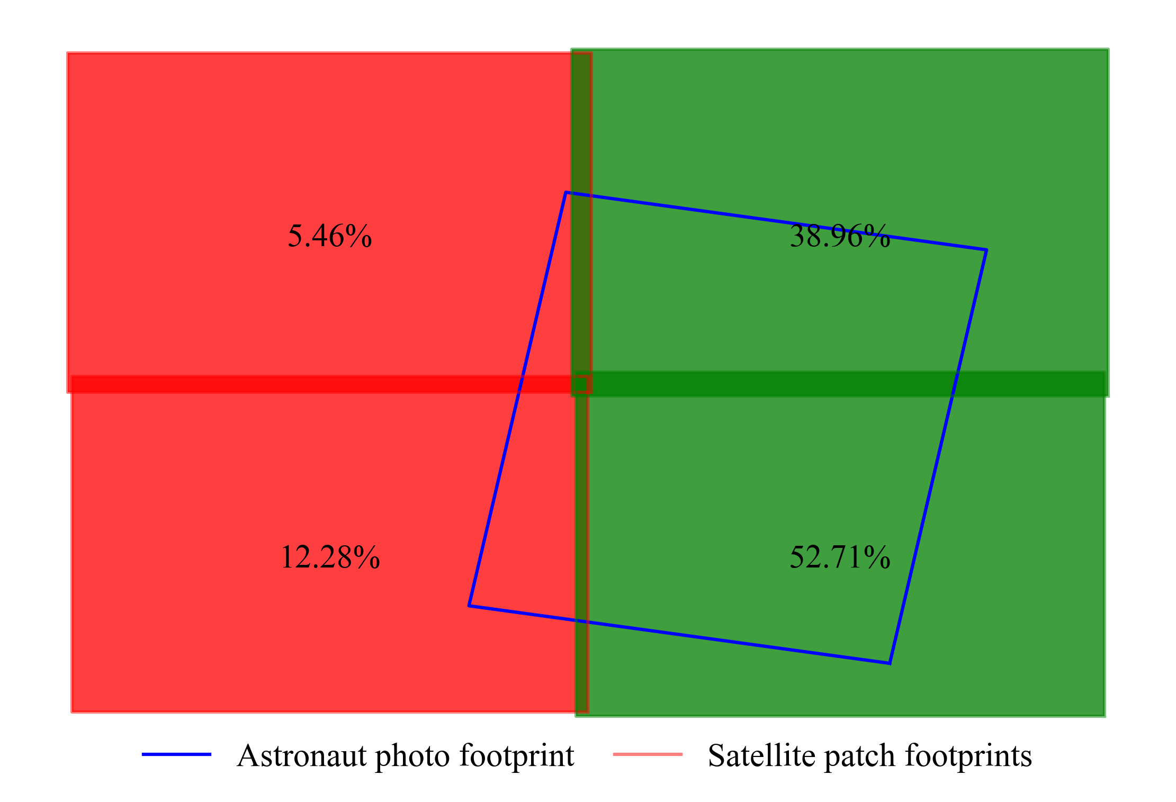
Finding a strong matcher
Challenge
Requirement
Patches will have incomplete overlap with astronaut photos
Matcher must be robust to “occlusion”
A Brief History of Astronaut Photography
The Find My Astronaut Photo Framework
Finding a Discriminative Matcher
Results
Barriers to Geolocation

Slide 18
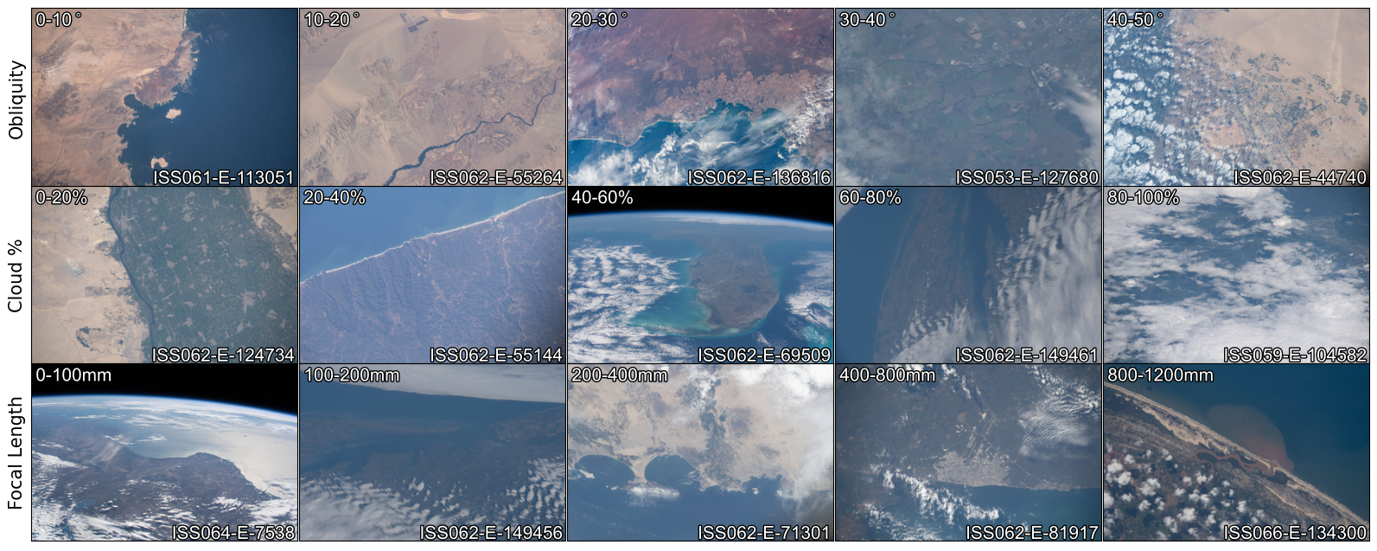
Finding a strong matcher
Challenge
Requirement
No canonical orientation (North is not always up)
Variable illumination conditions and seasonality
Can be nadir or highly oblique
Robust to rotation, illumination, occlusion, and viewing angle

Slide 19
Astronaut Image Matching Subset (AIMS)
323 astronaut photographs with expert human localization information
Variation across
Obliquity
Cloud % (occlusion)
Focal length (field of view/scale)
Orientation (North angle)
Astronaut photos, patch definitions, ground truth correct patches, satellite reference images released
Evaluative dataset for image matching
Input | Astronaut photo, indexed satellite ref. images
Output | Index of best matching reference image
Scoring | Precision/Recall
https://eol.jsc.nasa.gov/BeyondThePhotography/AstronautPhotographyImageMatchingSubset
A Brief History of Astronaut Photography
The Find My Astronaut Photo Framework
Finding a Discriminative Matcher
Results
Barriers to Geolocation

Slide 20
Evaluation
Run the Find My Astronaut Photo Pipeline on the AIMS set with each of the matchers to find optimal match criteria
Compare models using the optimal criteria for each method
For best performing class, evaluate the impact of image size and relative scale
Matcher Type | Embedding-based | Detector-based | Detector-free
Match Criteria | L2 Distance | Number of Inliers
 | Top-1
Matcher | NetVLAD (VGG16) | SIFT | LoFTR
 | GeM (Resnet-152) | SuperPoint + SuperGlue | SE2-LoFTR-8
 | DINO (ViT) | D2-Net | Matchformer
 | SwAV (Resnet-50 Wide-5) |  | Aspanformer
 | Barlow Twins (Resnet 50) |  | Patch2Pix
 | VicRegL (ConvNext) |  | DKM (v2)
A Brief History of Astronaut Photography
The Find My Astronaut Photo Framework
Finding a Discriminative Matcher
Results
Barriers to Geolocation

Slide 21
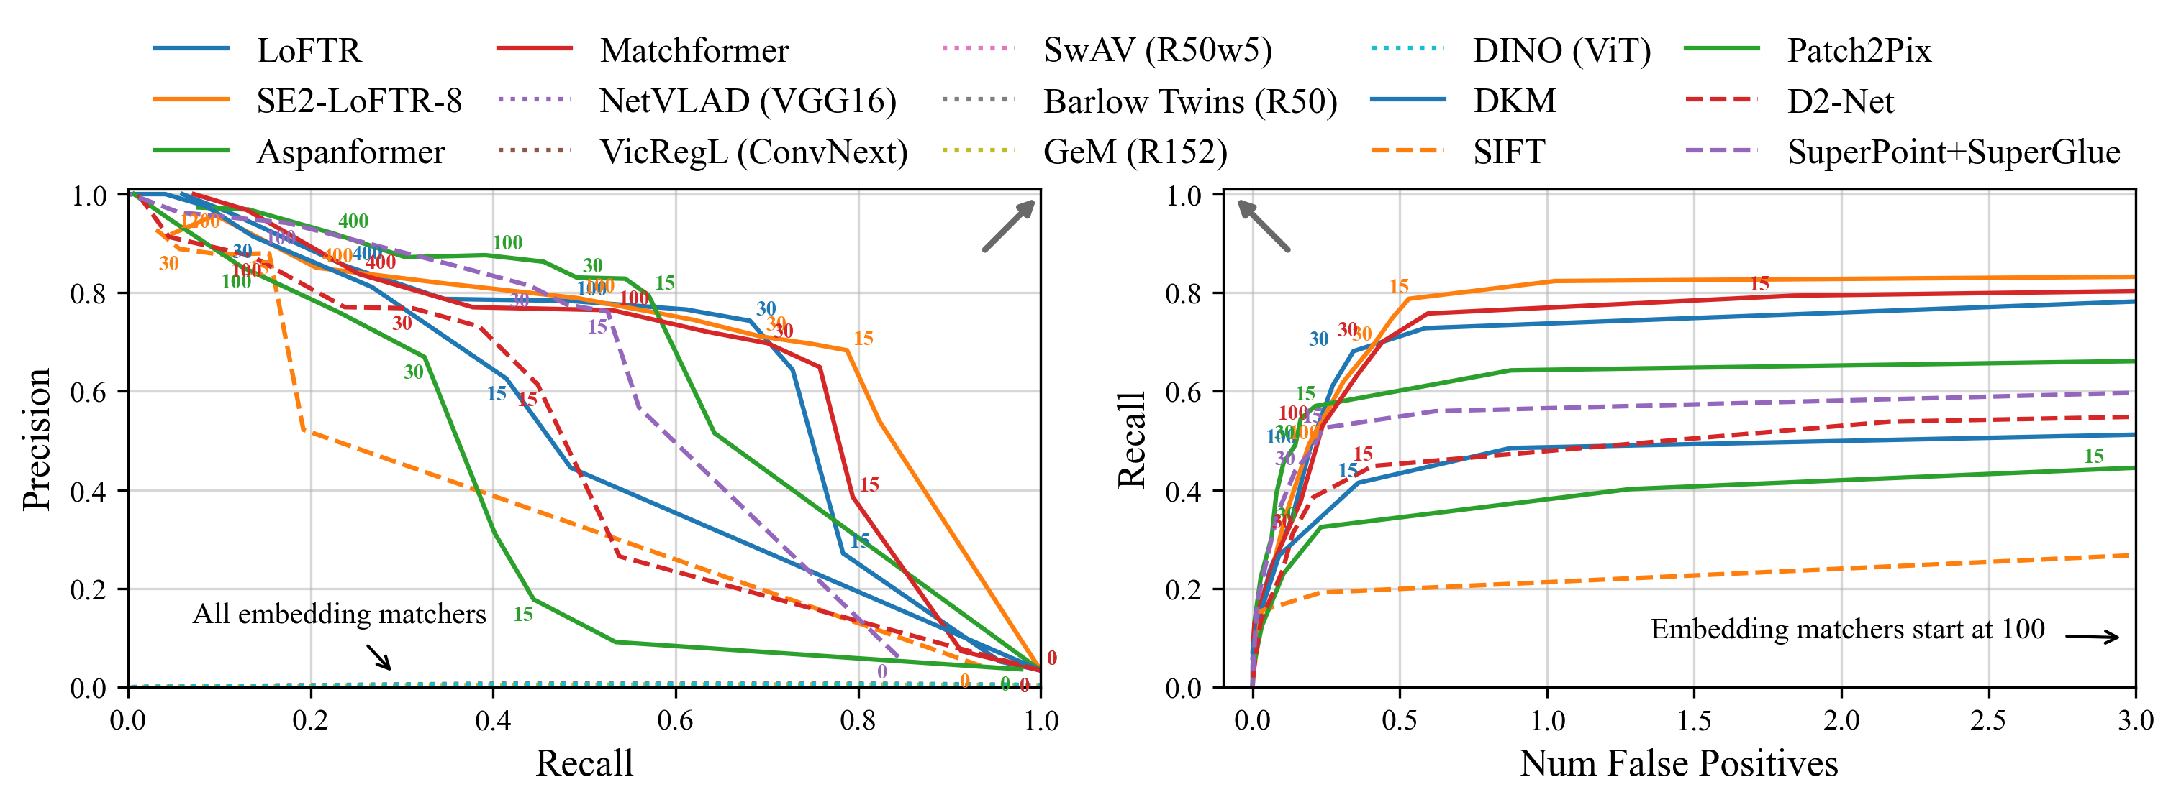
Results – Determining Optimal Criteria
Embedding based matchers are not discriminate enough in this setting
Using number of inliers as matching criteria, detector free matchers offer the best trade off between precision and recall
A Brief History of Astronaut Photography
The Find My Astronaut Photo Framework
Finding a Discriminative Matcher
Results
Barriers to Geolocation

Slide 22
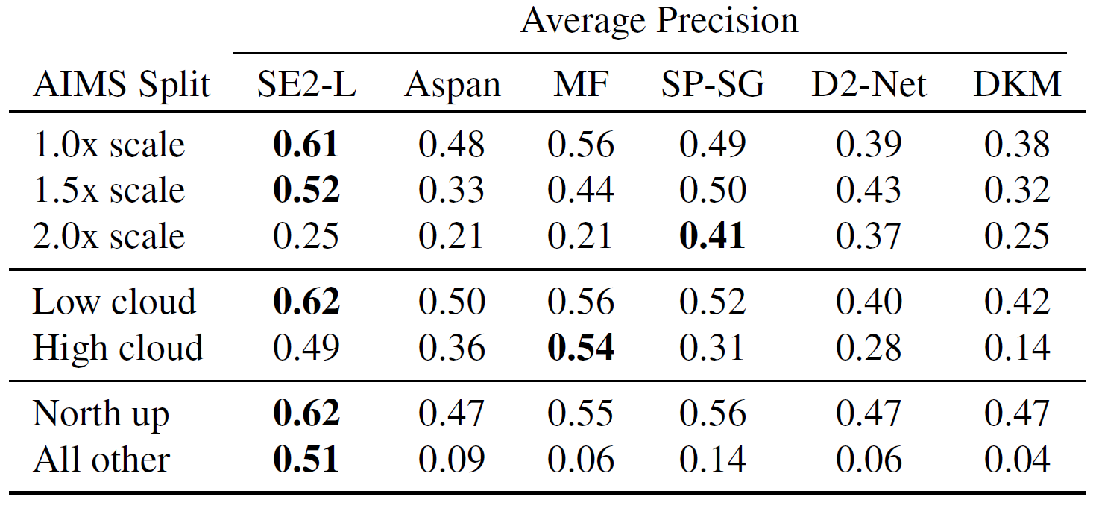
Results - AIMS Set Performance
Detector based matchers most robust to scale changes
Matchformer is most robust to occlusion
SE2-LoFTR is most robust to rotation (it is trained specifically for this setting)
Other matchers are quite poor for large rotations
We choose SE2-LoFTR to power Find My Astronaut Photo
A Brief History of Astronaut Photography
The Find My Astronaut Photo Framework
Finding a Discriminative Matcher
Results
Barriers to Geolocation

Slide 23
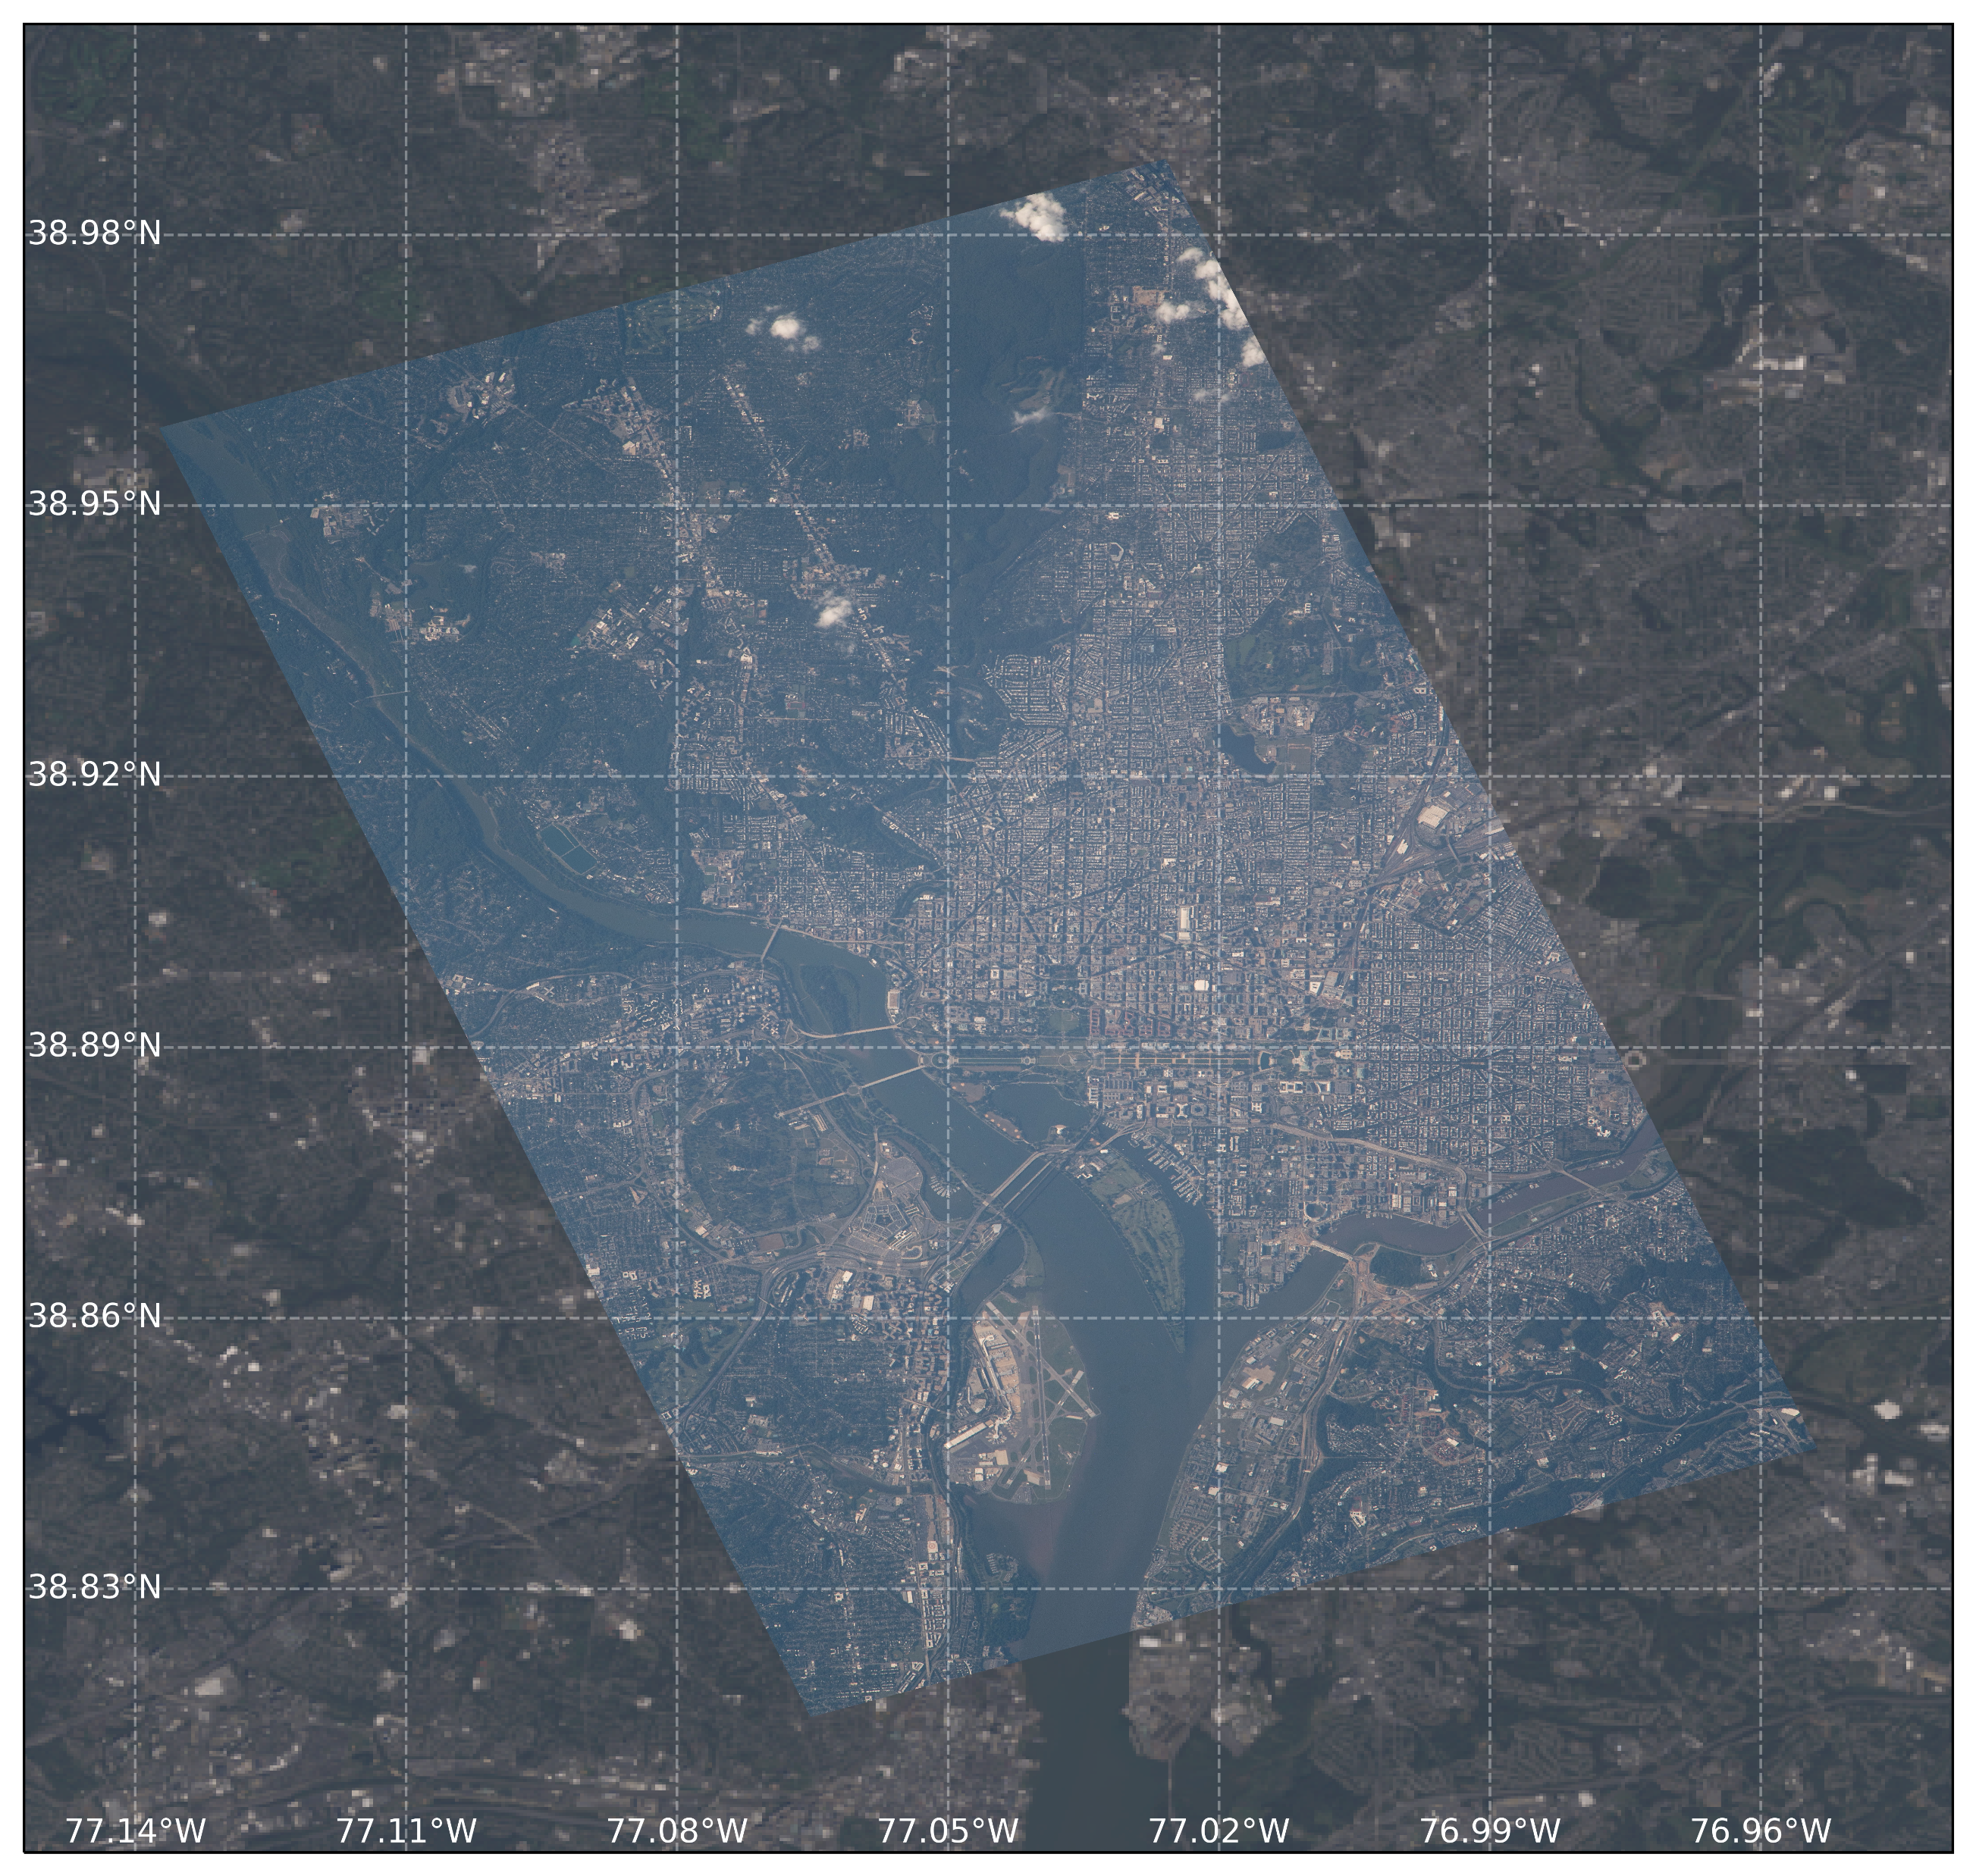
Acknowledgements and Next Steps
Total Images Found: 57,354
Explore additional matchers and matching methods
Engineering improvements to the pipeline to increase per photo speed
Add support for nighttime photography
Thanks to the Image Matching Workshop organizers, reviewers, and the image matching community!
https://eol.jsc.nasa.gov/
A Brief History of Astronaut Photography
The Find My Astronaut Photo Framework
Finding a Discriminative Matcher
Results
Barriers to Geolocation

